Slide 1
Graph(s)
Shoaib Rauf

Slide 2
Introduction to Graph
Graph is a non-linear data structure. It contains a set of points known as nodes (or vertices) and a set of links known as edges (or Arcs).
Graph is a collection of nodes and edges in which nodes are connected with edges
A graph G is represented as G = ( V , E ), where V is set of vertices and E is set of edges.

Slide 3
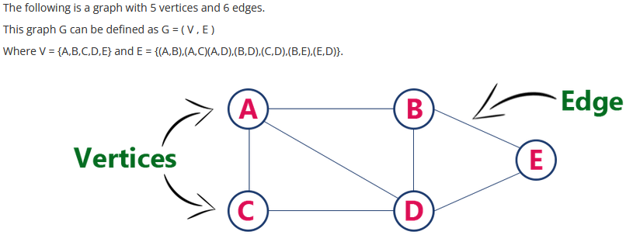
Introduction to Graph
Graph is a collection of nodes and edges in which nodes are connected with edges

Slide 4
Types of Graph:
Undirected Graph: A graph in which the edges do not have directions is called the Undirected graph.
Directed Graph: A graph in which the edges have directions associated with them is called a Directed graph.
Weighted Graph: The graph containing weighted edges is called a weighted graph.

Slide 5
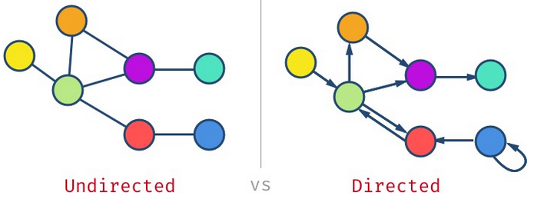
Directed & Undirected Graph
If the edges are bi-directional, then we have an undirected graph.
If the edges have a direction, then we have a directed graph or di-graph for short. You can think of it as a one-way street (directed) or two-way street (undirected)

Slide 6
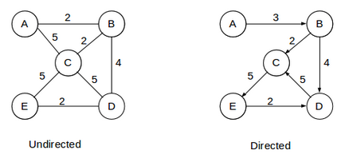
Weighted Graph
A positive value assigned to each edge indicating its length (distance between the vertices connected by an edge) is called weight.
The graph containing weighted edges is called a weighted graph. The weight of an edge e is denoted by w(e) and it indicates the cost of traversing an edge.

Slide 7
Terminologies
Vertex
Edge
Adjacent Node
Degree of the Node
Path
Closed Path
Simple Path
Cycle
Connected Graph
Complete Graph
Weighted Graph
Diagraph

Slide 8
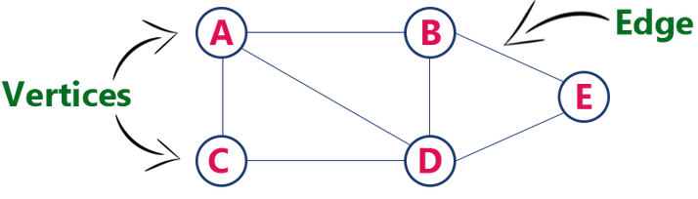
Vertex & Edge
Each node of the graph is called a vertex. In the above graph, A, B, C, and D are the vertices of the graph.
The link or path between two vertices is called an edge. It connects two or more vertices. The different edges in the above graph are (A,B),(A,C)(A,D),(B,D),(C,D),(B,E),(E,D).

Slide 9
Adjacent Node
In a graph, if two nodes are connected by an edge then they are called adjacent nodes or neighbors. In the following graph, vertices A and B are connected by edge AB. Thus A and B are adjacent nodes.

Slide 10
Degree of the Node
Total number of edges connected to a vertex is said to be degree of that vertex. In the given graph, node A has a degree 3
Node B = ?
Node C = ?
Node D = ?
Node E = ?

Slide 11
Path
The sequence of nodes that we need to follow when we have to travel from one vertex to another in a graph is called the path.
In our example graph, if we need to go from node A to E, then the path would be A->B->E

Slide 12
Closed Path
If the initial node is the same as a terminal node, then that path is termed as the closed path.
The vertex from which the path initiates is called “Initial Node” while the vertex into which the path terminates is called the “Terminal Node”.
In our example graph, if we need to go from node A to C, then the path would be A->B->E->D->C->A

Slide 13
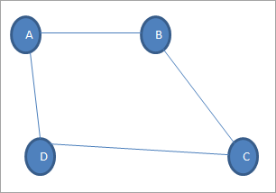
Cycle
A path in which there are no repeated edges or vertices and the first and last vertices are the same is called a cycle.
In our example graph, if we need to go from node A to C, then the path would be A->B->C->D->A

Slide 14
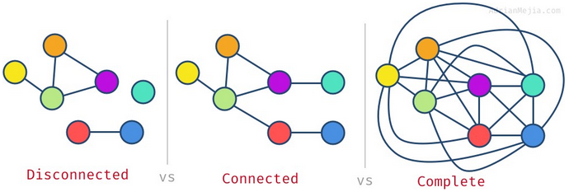
Disconnected, Connected and Complete Graph
Not all vertices have to be connected in the graph. You might have isolated nodes or even separated subgraphs. If all nodes have at least one edge, then we have a connected graph. When all nodes are connected to all other nodes, then we have a complete graph.

Slide 15
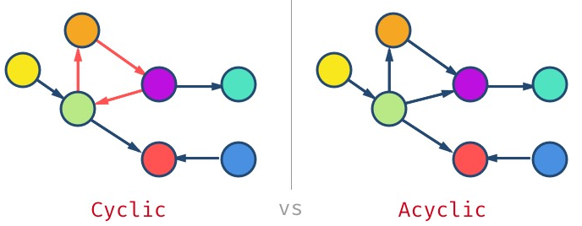
Cyclic and Acyclic Graph
A graph can have cycles, which means you could get the same node more than once. The graph without cycles is called acyclic graph.

Slide 16
Weighted Graph
A positive value assigned to each edge indicating its length (distance between the vertices connected by an edge) is called weight.
The graph containing weighted edges is called a weighted graph. The weight of an edge e is denoted by w(e) and it indicates the cost of traversing an edge.

Slide 17
Di-graph
If the edges are bi-directional, then we have an undirected graph.
If the edges have a direction, then we have a directed graph or di-graph for short. You can think of it as a one-way street (directed) or two-way street (undirected)

Slide 18
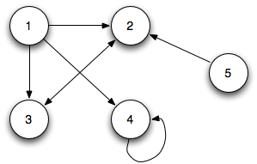
Self Loop
Edge (undirected or directed) is a self-loop if its two endpoints coincide with each other.

Slide 19
Graph Representation
Adjacency Matrix: {Directed, Un-Directed and Weighted}
Incidence Matrix: {Directed}
Adjacency List or Linked Representation
{Directed, Un-Directed and Weighted}

Slide 20
Graph Representation: Adjacency Matrix
In this representation, the graph is represented using a matrix of size total number of vertices by a total number of vertices.
That means a graph with 4 vertices is represented using a matrix of size 4X4.
In this matrix, both rows and columns represent vertices. This matrix is filled with either 1 or 0.
Here, 1 represents that there is an edge from row vertex to column vertex and 0 represents that there is no edge from row vertex to column vertex.

Slide 21
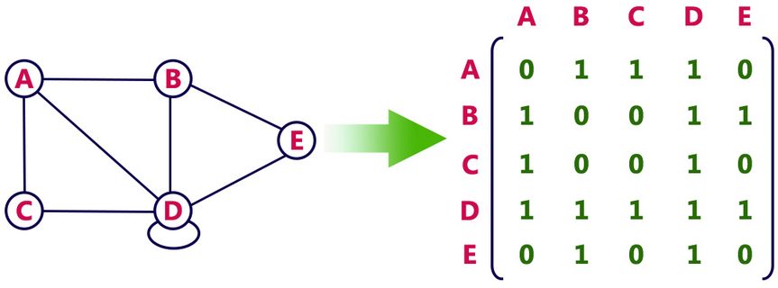
Graph Representation: Adjacency Matrix
For Undirected graph

Slide 22
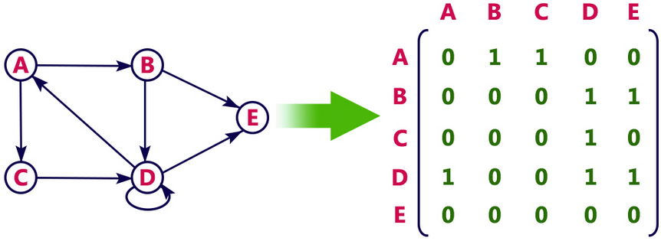
Graph Representation: Adjacency Matrix
For Directed graph

Slide 23
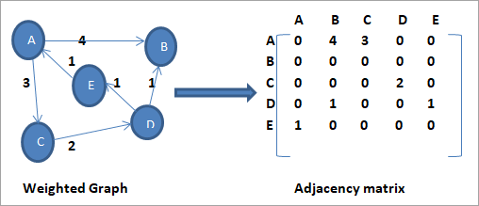
Graph Representation: Adjacency Matrix
For Weighted graph

Slide 24
Graph Representation: Incidence Matrix
In this representation, the graph is represented using a matrix of size total number of vertices by a total number of edges.
That means graph with 4 vertices and 6 edges is represented using a matrix of size 4X6.
In this matrix, rows represent vertices and columns represents edges. This matrix is filled with 0 or 1 or -1.
Here, 0 represents that the row edge is not connected to column vertex, 1 represents that the row edge is connected as the outgoing edge to column vertex and -1 represents that the row edge is connected as the incoming edge to column vertex.

Slide 25
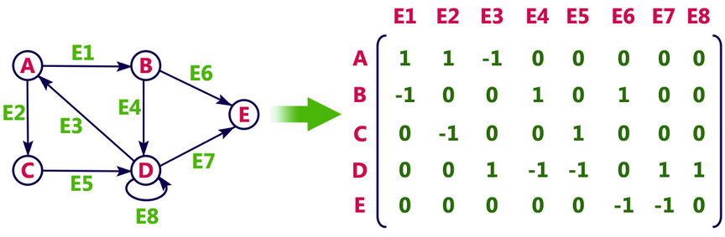
Graph Representation: Incidence Matrix
For Directed graph

Slide 26
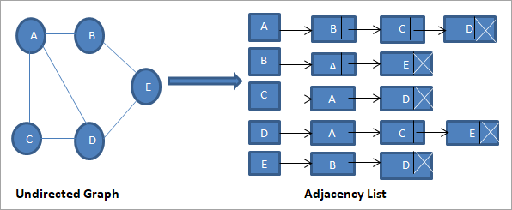
Graph Representation: Adjacency List
Undirected Graph: In this representation, every vertex of a graph contains list of its adjacent vertices.

Slide 27
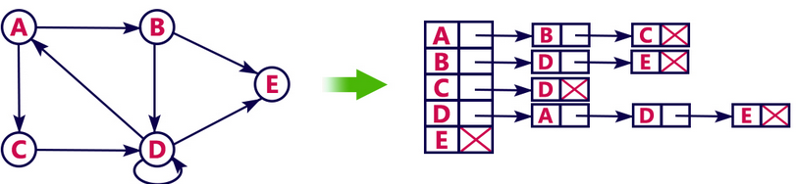
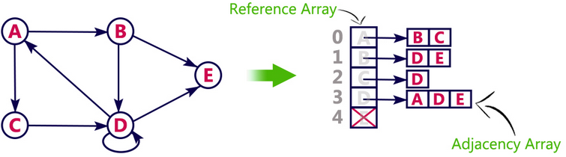
Graph Representation: Adjacency List
Directed Graph: In this representation, every vertex of a graph contains list of its adjacent vertices.

Slide 28
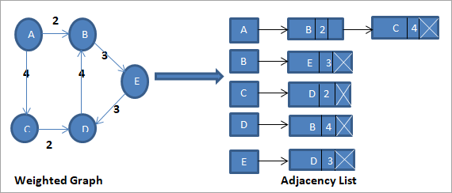
Graph Representation: Adjacency List
Weighted Graph: In this representation, every vertex of a graph contains list of its adjacent vertices.

Slide 29
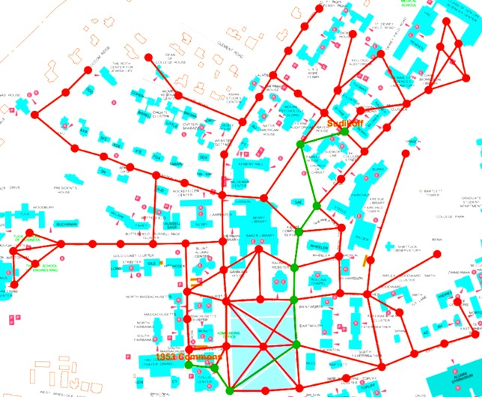
Graph Application

Slide 30
Graph Applications
In general, graphs have many real-world applications like:
Electronic circuits
Flight reservations
Driving directions
Telcom: Cell tower frequency planning
Social networks. E.g., Facebook uses a graph for suggesting friends
Recommendations: Amazon/Netflix uses graphs to make suggestions for products/movies
Graphs help to plan the logistics of delivering goods

Slide 31
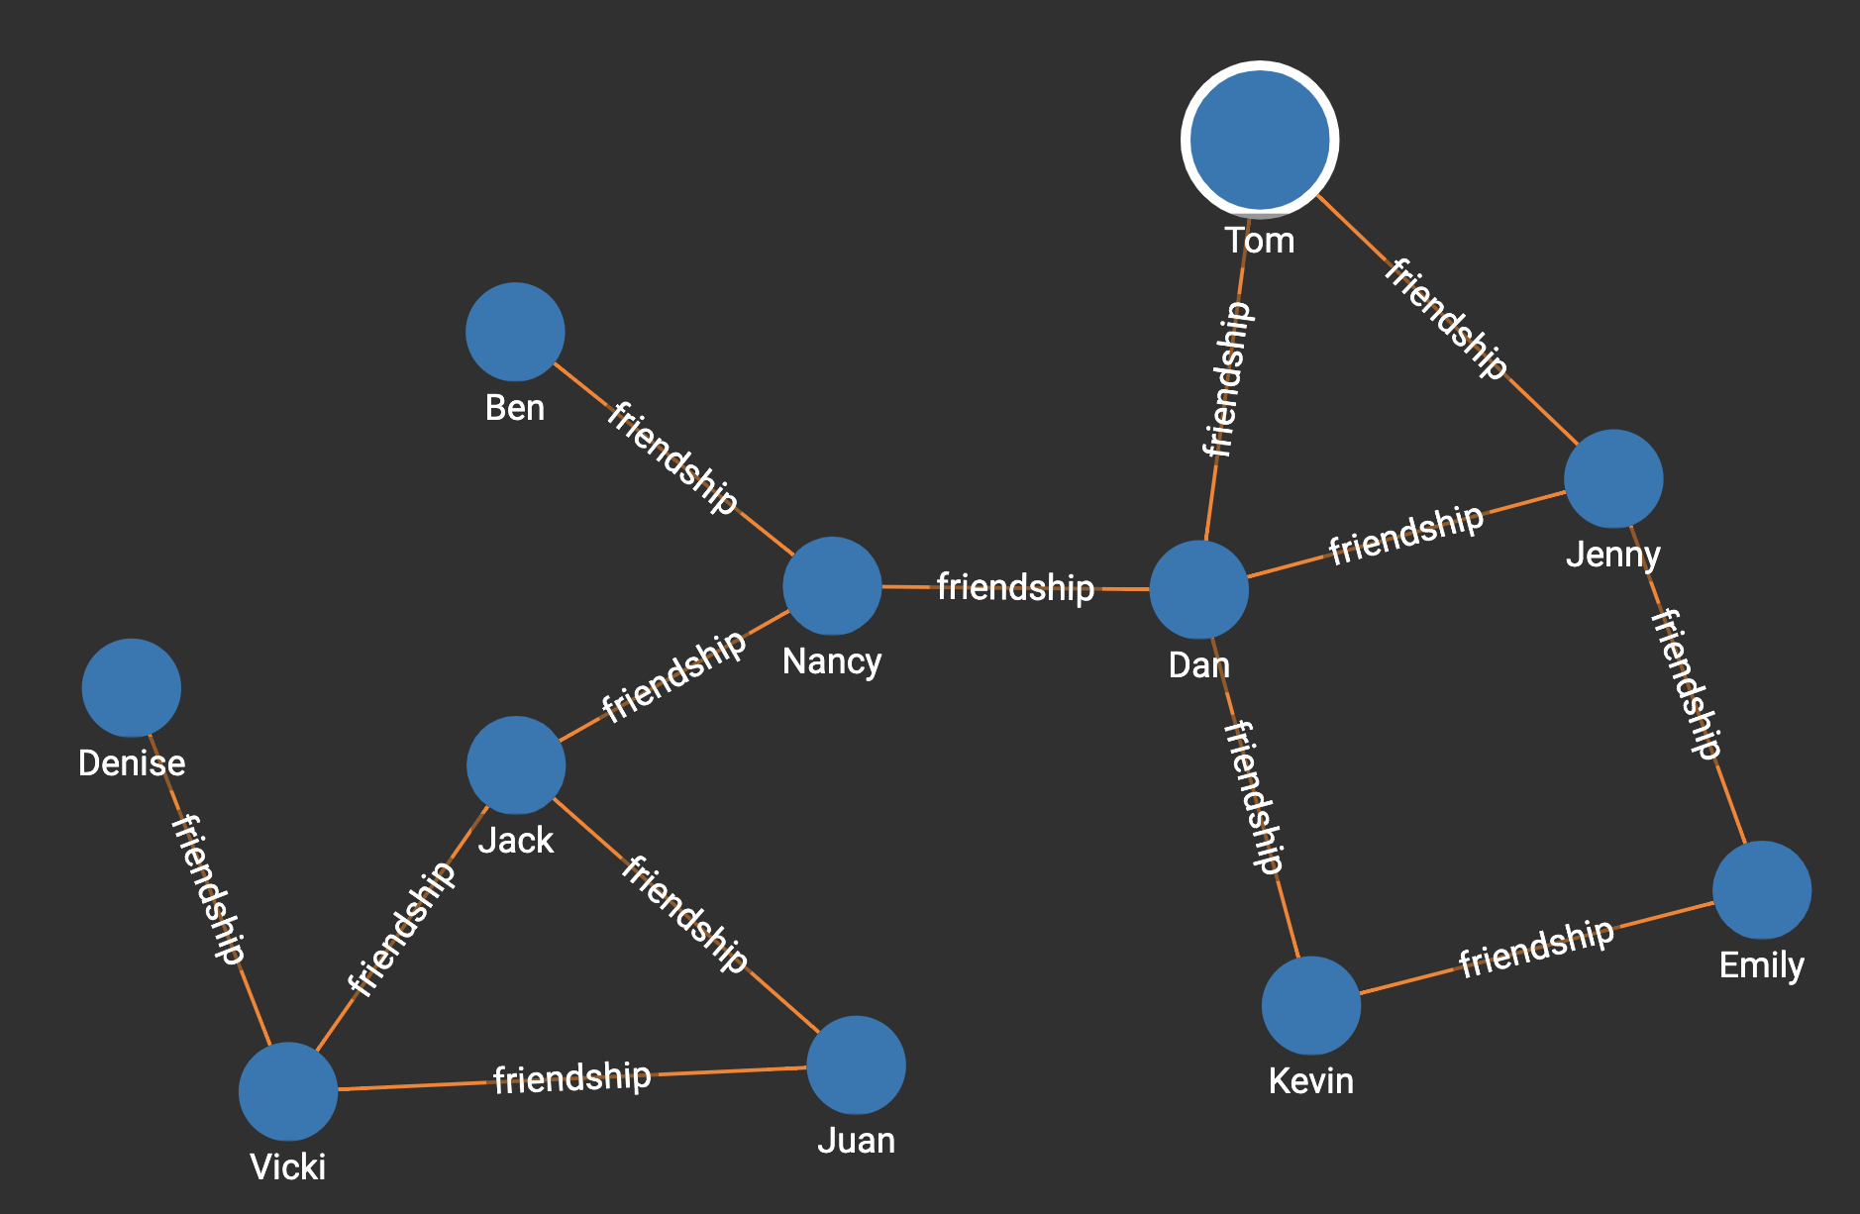
Friendship Network

Slide 32
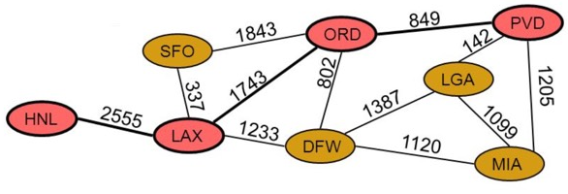
Graph Applications
Airline Traffic (image above)
Node/vertex = Airport
Edges = direct flights between two airports
Weight = miles between two airports
GPS Navigation
Node = road intersection
Edge = road
Weight = time required to go from one intersection to another
Networks routing
Node = server
Edge = data link
Weight = connection speed

Slide 33
Graph Traversing
Breadth First Algorithm
Depth First Algorithm

Slide 34
Graph traversal is a technique used for a searching vertex in a graph.
The graph traversal is also used to decide the order of vertices is visited in the search process.
A graph traversal finds the edges to be used in the search process without creating loops. That means using graph traversal we visit all the vertices of the graph without getting into looping path.
There are two graph traversal techniques and they are as follows...
DFS (Depth First Search)
BFS (Breadth First Search)

Slide 35
DFS (Depth First Search)
DFS traversal of a graph produces a spanning tree as final result. Spanning Tree is a graph without loops.
We use Stack data structure with maximum size of total number of vertices in the graph to implement DFS traversal.

Slide 36
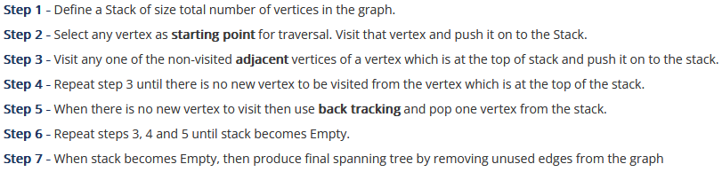
Algorithm (DFS):

Slide 37
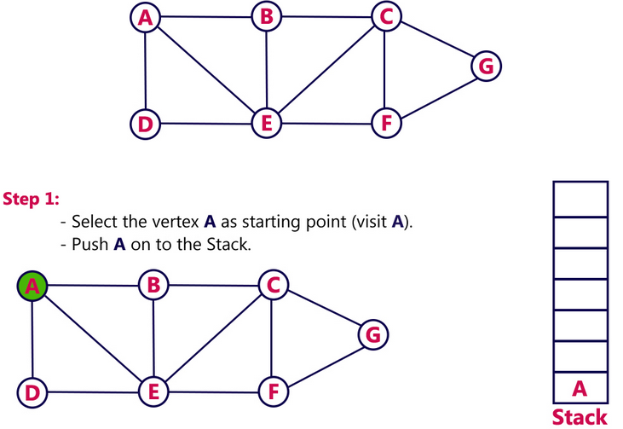
DFS

Slide 38
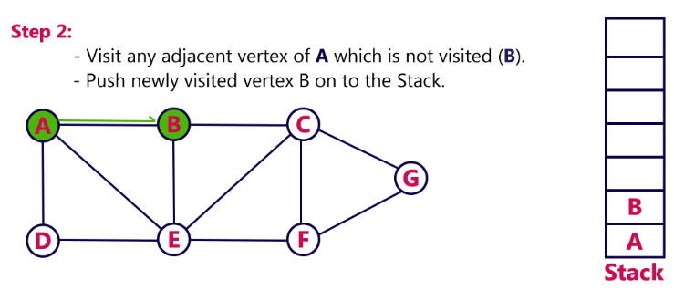
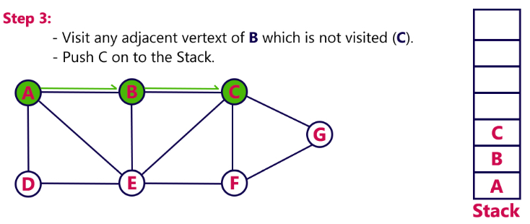
DFS

Slide 39
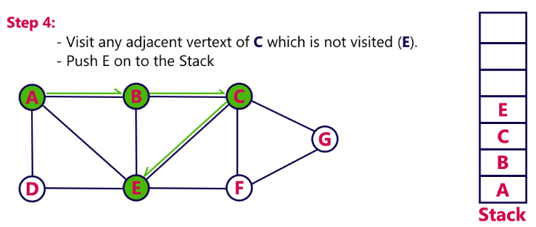
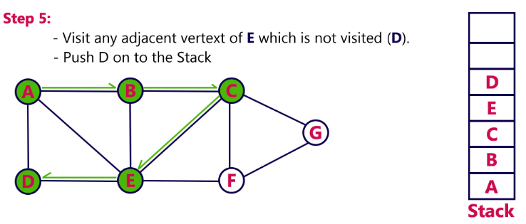
DFS

Slide 40
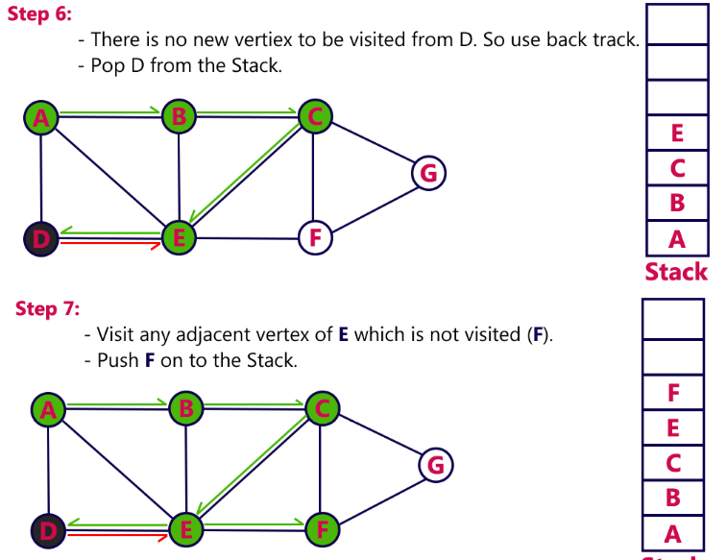
DFS

Slide 41
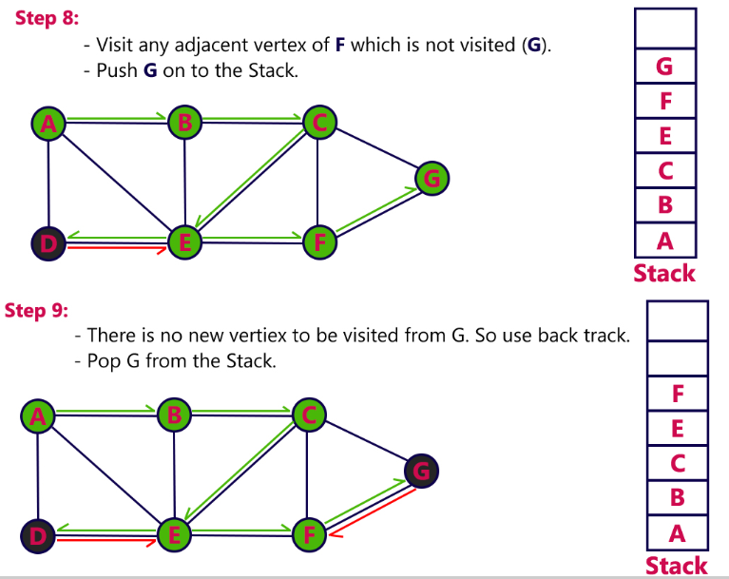
DFS

Slide 42
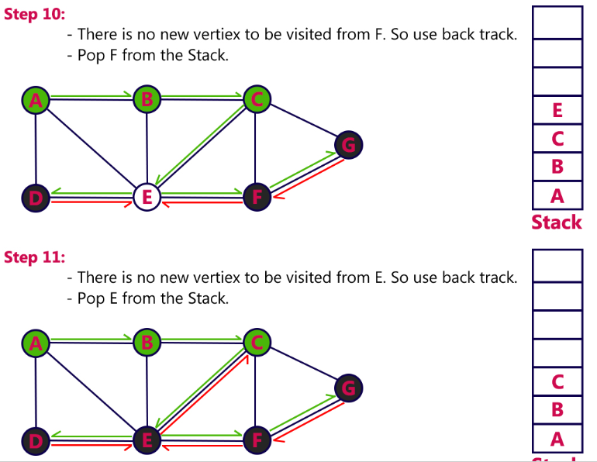
DFS

Slide 43
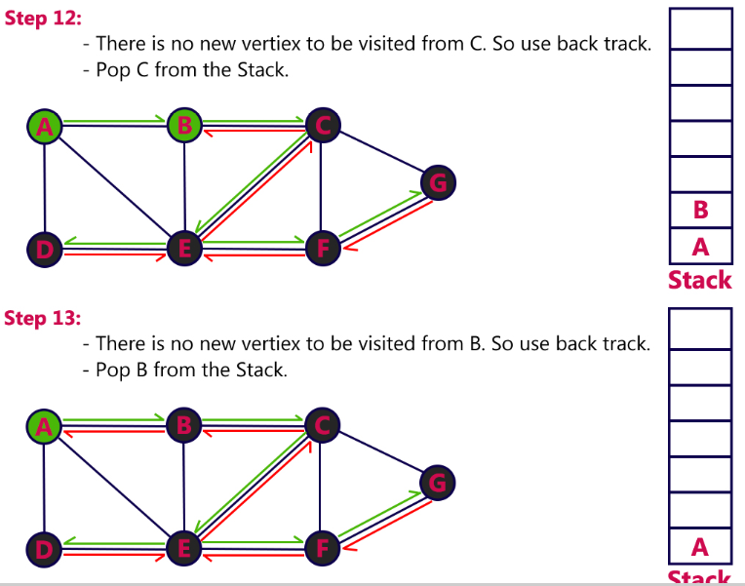
DFS

Slide 44
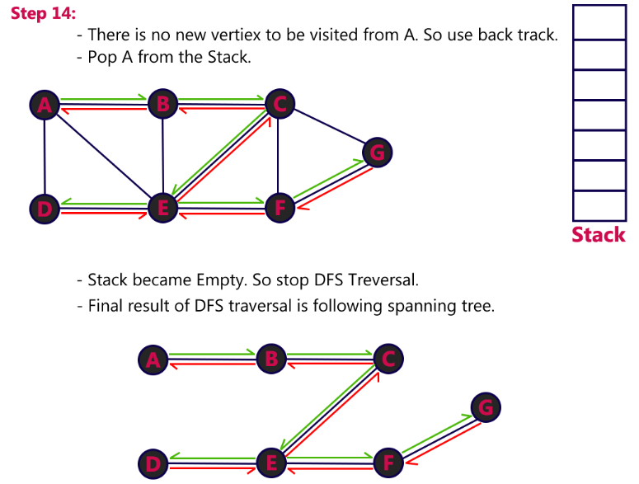
DFS

Slide 45
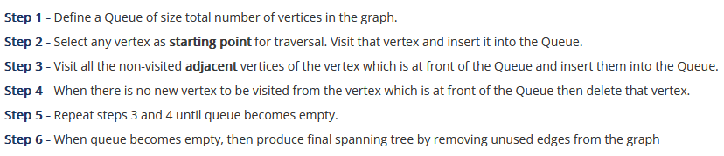
Algorithm (BFS):

Slide 46
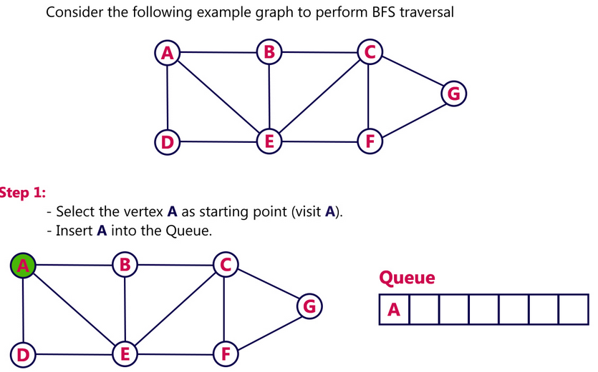
BFS

Slide 47
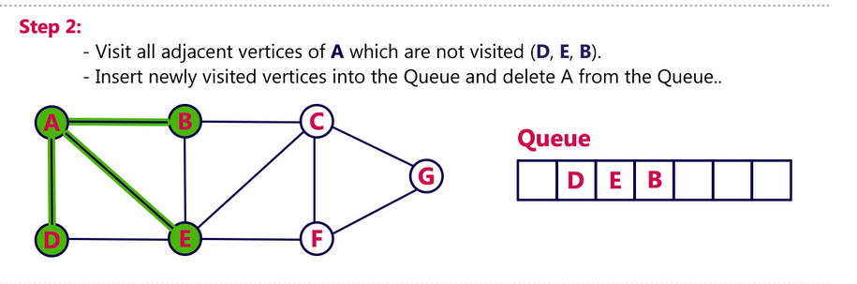
BFS

Slide 48
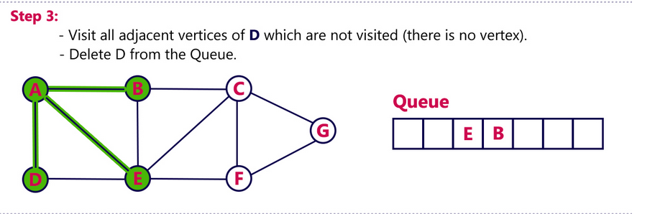
BFS

Slide 49
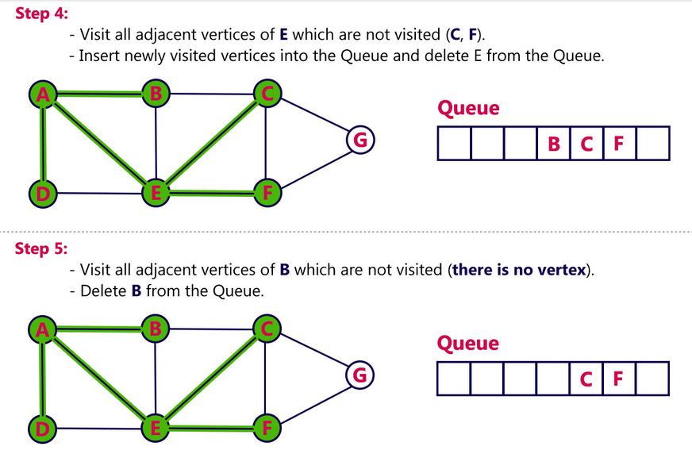
BFS

Slide 50
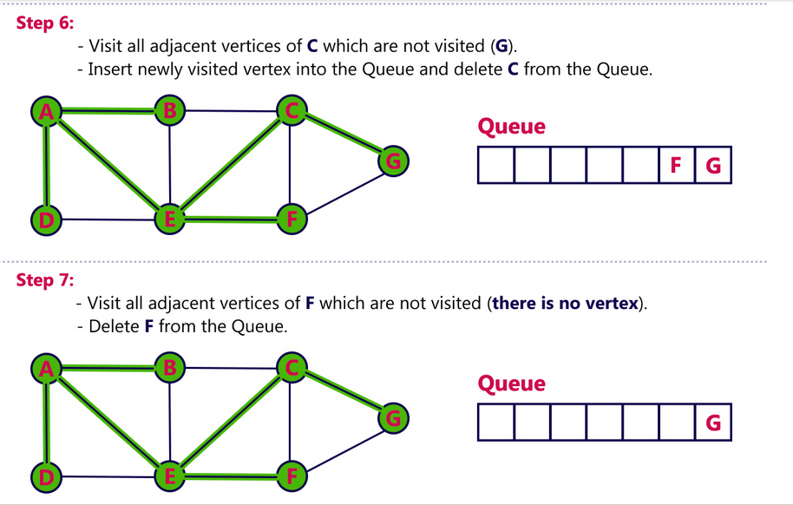
BFS

Slide 51
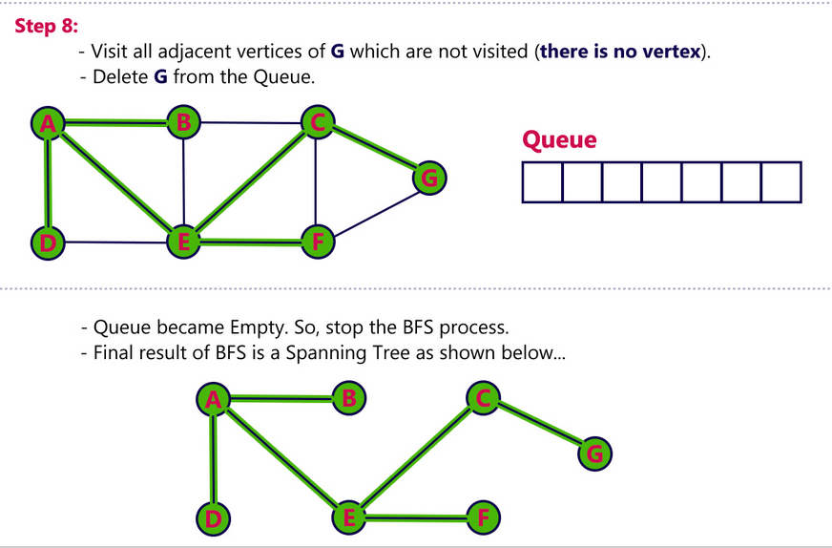
BFS

Slide 52
Shortest Path First
Dijkstra's Algorithm

Slide 53
Dijkstra’s Algorithm
Dijkstra’s algorithm is also known as the shortest path algorithm.
It is an algorithm used to find the shortest path between nodes of the graph.
The algorithm creates the tree of the shortest paths from the starting source vertex from all other points in the graph.
It differs from the minimum spanning tree as the shortest distance between two vertices may not be included in all the vertices of the graph.
The algorithm works by building a set of nodes that have a minimum distance from the source. Here, Dijkstra's algorithm uses a greedy approach to solve the problem and find the best solution.

Slide 54
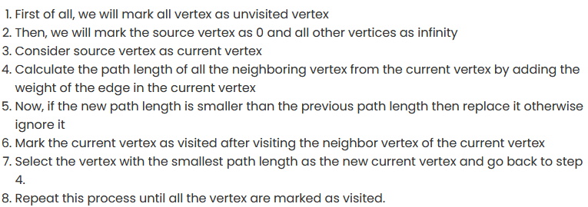
Dijkstra’s Algorithm
Once we go through the algorithm, we can backtrack the source vertex and find our shortest path.

Slide 55
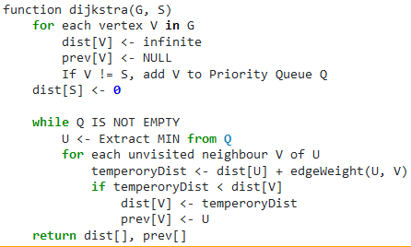
Pseudocode of Dijkstra’s Algorithm

Slide 56
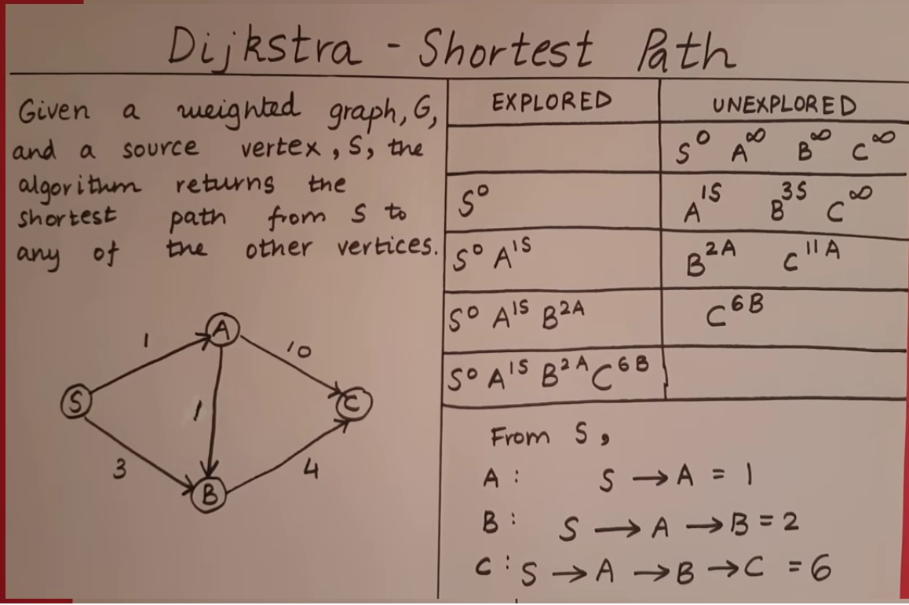
Dijkstra’s algorithm

Slide 57
Spanning Tree
Prim's algorithm
Kruskal's algorithm

Slide 58
Spanning Tree
A spanning tree can be defined as the subgraph of an undirected connected graph.
It includes all the vertices along with the least possible number of edges. If any vertex is missed, it is not a spanning tree.
A spanning tree is a subset of the graph that does not have cycles, and it also cannot be disconnected
A spanning tree consists of (n-1) edges, where 'n' is the number of vertices (or nodes).
Edges of the spanning tree may or may not have weights assigned to them.

Slide 59
Spanning Tree
All the possible spanning trees created from the given graph G would have the same number of vertices, but the number of edges in the spanning tree would be equal to the number of vertices in the given graph minus 1.
A complete undirected graph can have number of spanning trees where is the number of vertices in the graph.
Suppose, if n = 5, the number of maximum possible spanning trees would be 55-2 = 125.

Slide 60
Spanning Tree
All the possible spanning trees created from the given graph G would have the same number of vertices, but the number of edges in the spanning tree would be equal to the number of vertices in the given graph minus 1.
A complete undirected graph can have number of spanning trees where is the number of vertices in the graph.
Suppose, if n = 5, the number of maximum possible spanning trees would be 55-2 = 125.

Slide 61
Spanning Tree
All the possible spanning trees created from the given graph G would have the same number of vertices, but the number of edges in the spanning tree would be equal to the number of vertices in the given graph minus 1.
A complete undirected graph can have number of spanning trees where is the number of vertices in the graph.
Suppose, if n = 5, the number of maximum possible spanning trees would be 55-2 = 125.

Slide 62
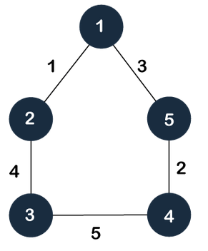
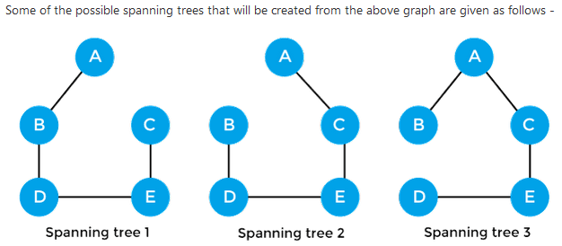
Spanning Tree

Slide 63
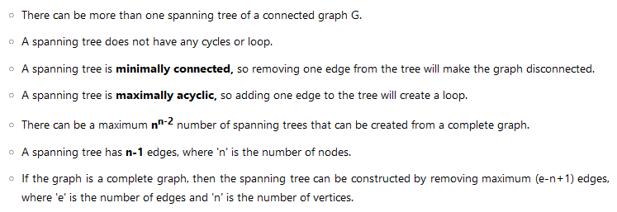
Spanning Tree: Properties

Slide 64
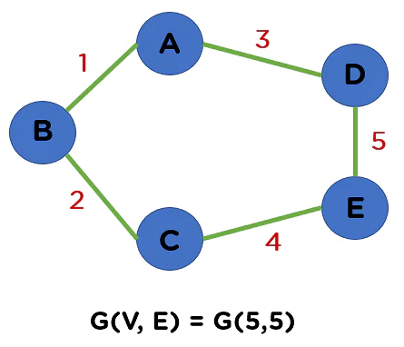
Minimum Spanning Tree
A minimum spanning tree can be defined as the spanning tree in which the sum of the weights of the edge is minimum.
The weight of the spanning tree is the sum of the weights given to the edges of the spanning tree.
In the real world, this weight can be considered as the distance, traffic load, congestion, or any random value.

Slide 65
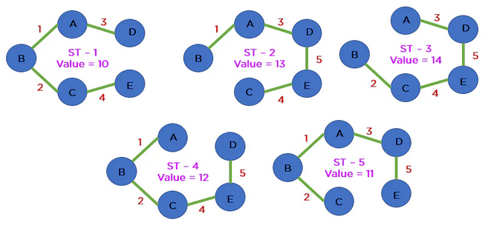
Minimum Spanning Tree
A minimum spanning tree is ST-1 with the weight of 10

Slide 66
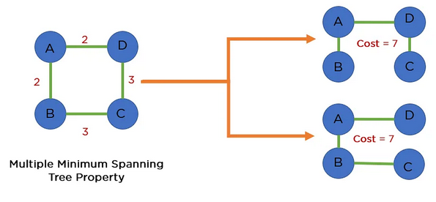
Minimum Spanning Tree
There is a possibility of more than 1 Minimum Spanning tree.

Slide 67
Application of a Spanning Tree
Telecommunication Network Building: If we want to develop a telecommunication network for the entire city, a basic naive approach will be more expensive.
Constructing Highways or Railroads: For constructing highways or railroads the Minimum Spanning Tree approach is utilized everywhere.
Given the possible routes between two cities, MST technique provides you with the optimal route.
Basically, the algorithm treats the cities as the vertices and paths joining them as edges to create a subtree that will make the route fully connected and cost efficient.

Slide 68
Prim’s Algorithm
Prim's Algorithm is a greedy algorithm that is used to find the minimum spanning tree from a graph.
Prim's algorithm finds the subset of edges that includes every vertex of the graph such that the sum of the weights of the edges can be minimized.
Prim's algorithm starts with the single node and explores all the adjacent nodes with all the connecting edges at every step.
The edges with the minimal weights causing no cycles in the graph got selected.

Slide 69
Prim’s Algorithm
To implement the prim's algorithm following are the steps.
First, we have to initialize an MST with the randomly chosen vertex.
Now, we have to find all the edges that connect the tree in the above step with the new vertices. From the edges found, select the minimum edge and add it to the tree.
Repeat step 2 until the minimum spanning tree is formed.

Slide 70
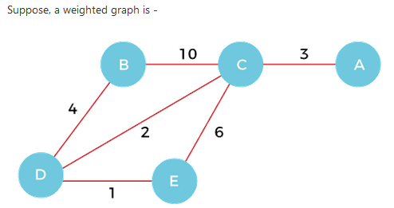
Prims Algorithm

Slide 71

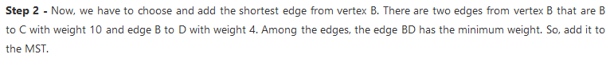
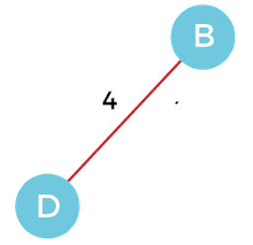
Prims Algorithm

Slide 72
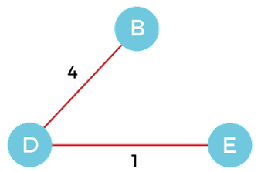

Prims Algorithm

Slide 73

Prims Algorithm
So, the graph produced in step 5 is the minimum spanning tree of the given graph. The cost of the MST is given below -
Cost of MST = 4 + 2 + 1 + 3 = 10 units.

Slide 74
Kruskal's Algorithm
It is used to find the minimum spanning tree for a connected weighted graph.
The main target of the algorithm is to find the subset of edges by using which we can traverse every vertex of the graph.
It follows the greedy approach that finds an optimum solution at every stage instead of focusing on a global optimum.
OR
In Kruskal's algorithm, we start from edges with the lowest weight and keep adding the edges until the goal is reached.

Slide 75
Kruskal's Algorithm
It is used to find the minimum spanning tree for a connected weighted graph.
The main target of the algorithm is to find the subset of edges by using which we can traverse every vertex of the graph.
It follows the greedy approach that finds an optimum solution at every stage instead of focusing on a global optimum.
OR
In Kruskal's algorithm, we start from edges with the lowest weight and keep adding the edges until the goal is reached.

Slide 76
Kruskal's Algorithm
To implement the kruskal's algorithm following are the steps.
First, sort all the edges from low weight to high.
Now, take the edge with the lowest weight and add it to the spanning tree. If the edge to be added creates a cycle, then reject the edge.
Continue to add the edges until we reach all vertices, and a minimum spanning tree is created.

Slide 77


Kruskal's Algorithm
Now, let's see the working of Kruskal's algorithm using an example. It will be easier to understand Kruskal's algorithm using an example.
Suppose a weighted graph is -

Slide 78

Kruskal's Algorithm
Now, sort the edges given above in the ascending order of their weights.

Slide 79

Kruskal's Algorithm
Now, let's start constructing the minimum spanning tree.
Step 1 - First, add the edge AB with weight 1 to the MST.

Slide 80

Kruskal's Algorithm
Step 2 - Add the edge DE with weight 2 to the MST as it is not creating the cycle.

Slide 81


Kruskal's Algorithm
Step 3 - Add the edge BC with weight 3 to the MST, as it is not creating any cycle or loop.
Step 4 - Now, pick the edge CD with weight 4 to the MST, as it is not forming the cycle.

Slide 82
Kruskal's Algorithm
Step 5 - After that, pick the edge AE with weight 5. Including this edge will create the cycle, so discard it.
Step 6 - Pick the edge AC with weight 7. Including this edge will create the cycle, so discard it.
Step 7 - Pick the edge AD with weight 10. Including this edge will also create the cycle, so discard it.

Slide 83

Kruskal's Algorithm
So, the final minimum spanning tree obtained from the given weighted graph by using Kruskal's algorithm is
The cost of the MST is = AB + DE + BC + CD = 1 + 2 + 3 + 4 = 10.
Now, the number of edges in the above tree equals the number of vertices minus 1. So, the algorithm stops here.

